Slide 2
The artist generally known as the “King of Rock and Roll” was:

Slide 3
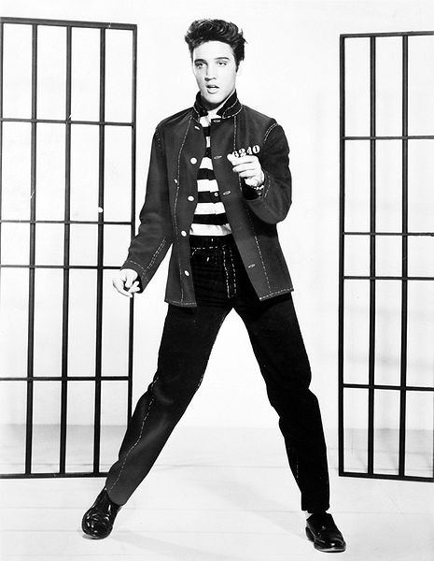
Discovered in 1954, Elvis became a national star by 1956-1957.
Elvis served in the _______
from 1958-1960
US army

Slide 4
Elvis’s Hit Songs included:
H____ D__
Hound Dog
Blue Suede Shoes
B___ S____ S____
L___ M_ T______
Love Me Tender
J_______ R____
Jailhouse Rock
Return to Sender
R____ t_ S_____
S_________ M____
Suspicious Minds

Slide 5
Elvis died from a drug
overdose in ______
1977
Even today people still visit his former home called “G_______”
“Graceland”

Slide 6
Trivia
Television stations were only allowed to film elvis ......
from the waist up!
of the
This was because of the way he moved his hips when he danced, which was considered too suggestive for his day.

